Slide 1


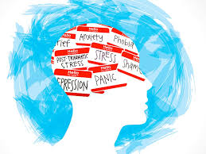
Mental Health Prediction Using Machine Learning
Guide name:Mrs.M R Nithya
Team Members:Arthy M(CB2207)
Reena S(CB2244)
Shree Harini S(CB2250)
Soundharya AL(CB2252)

Slide 2
Machine learning
Machine learning is a subfield of artificial intelligence, which is broadly defined as the capability of a machine to imitate intelligent human behavior.
Artificial intelligence systems are used to perform complex tasks in a way that is similar to how humans solve problems.
machine learning enables computers to learn from data and make decisions or predictions without being explicitly programmed to do so.
Types:supervised, semi-supervised, unsupervised and reinforcement.

Slide 3
Abstract
Machine learning, a subset of artificial intelligence, can play a crucial role in detecting mental illnesses. This study proposes using the decision tree classifier algorithm to identify mental health conditions like anxiety, depression, and stress by analyzing recorded datasets. The main aim to this project user friendly and provide better solution through the login.The goal is to create a training model that can predict the target variable class. Additionally, the random forest algorithm is applied to predict mental illnesses, resulting in a more accurate prediction level compared to existing models. This research aims to provide an ideal solution for detecting mental health conditions and percentage of mental health issue using machine learning algorithms.

Slide 4

Introduction
Mental health prediction using machine learning is the process of using computer algorithms to analyze data and identify patterns that can help predict the onset or severity of mental health conditions like depression or anxiety.
This allows for earlier detection and more personalized treatment options.
Key Components
Data Collection
Feature Extraction
Machine Learning Models
Prediction and Monitoring

Slide 5
Problem Statement
Develop a training model to predict mental health conditions with high accuracy .Compare the performance of decision tree classifier and random forest algorithms. Identify key factors contributing to mental health conditions .Design a user-friendly interface for data input and result interpretation. Evaluate the model's effectiveness in detecting mental health conditions.
Mental health conditions such as anxiety, depression, and stress are increasingly prevalent, affecting millions worldwide. Current diagnostic methods rely heavily on manual assessments, which can be subjective, time-consuming, and often lead to delayed interventions. Existing machine learning models for mental health prediction lack accuracy, scalability, and user-friendliness.

Slide 6
Literature review
TOPIC | AUTHOR & YEAR OF PUBLICATION | ALGORITHM | DIADVANTAGES
A machine learning algorithm to differentiate bipolar disorder from major depressive disorder using an online mental health questionnaire and | Tomasik et al. Translational Psychiatry (2021) | Decision tree,Support vector machine,logistic regression ,random forest,linear regression,K nearest neighbour | Data Privacy Concerns Ethical Concerns
Application of Machine Learning Methods in Mental Health Detection: A Systematic Review | ROHIZAH ABD RAHMAN 1 (2020) | Machine learning algorithm with deep learning technique | Lack of standardization Rapidly evolving field
Judging Mental Health Disorders Using Decision Tree models | Sandip Roy , P. S. Aithal , Rajesh Boseh (2021) | Decision tree | Overfitting Bias Sensitivity
Employing Artificial Intelligence Techniques in | Rozita Yati Masri, Hajar Mat Jani (2012) | Fuzzy genetic algorithm, | Data Dependency Trust issues
Prediction of Mental Health Problems Among Children Using Machine Learning Techniques | Ms. Sumathi M.R., Research Scholar (2016) | Multilayer perception,multiclass classifier and LAD tree | Limited Data Availability Data sensitivity

Slide 7
Mental health prediction using ML existing System
1. PSYCHOSIS PREDICTION SYSTEM: Utilizes MRI scans and ML algorithms to predict psychosis onset.
2. Mental Health Screening Tool (MHST): Employs natural language processing (NLP) and ML to identify mental health risks.
3. Predictive Analytics for Mental Health (PAMH): Analyzes electronic health records (EHRs) to predict mental health outcomes.
4. Mental Health Forecast (MHF): Uses social media data and ML to predict depression and anxiety.
5. Clinical Decision Support System (CDSS): Integrates ML with EHRs to predict mental health diagnoses.

Slide 8
Disadvantages of existing system
Limited contextual understanding: ML models may not fully understand the complexities of human behavior, emotions, and social context.
Data quality issues: Poor data quality, bias, or incomplete information can lead to inaccurate predictions.
Patient privacy concerns: Using sensitive personal data for ML predictions raises privacy and confidentiality concerns.
Continuous updating and maintenance: ML models require regular updating and maintenance to ensure accuracy and relevance.
Regulatory and ethical challenges: There is a need for clear guidelines and regulations on developing and deploying ML-based mental health prediction systems.

Slide 9
PROPOSED SYSTEM
The initial step is data collection.
We have tried to collect data from different places about that symptoms. Hence, we had to collect all the data ourselves.
We made a survey form for each mental issues and distributed, both online and offline for people to fill it.
Next we have to create login page for the user .
The user will give some input and compared with our dataset .
Then illness is predicted with percentage,give some suitable medication

Slide 10
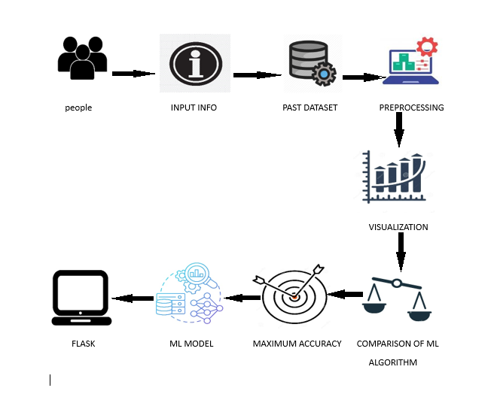
SYSTEM ARCHITECTURE

Slide 11
SYSTEM ARCHITECTURE
The Mental Health Prediction System is designed to leverage machine learning techniques for predicting mental health conditions based on user input and historical data.
This architecture encompasses several key components that facilitate data collection, processing, modeling, and output generation.
The architecture of the Mental Health Prediction System is designed to be user-centric, data-driven, and analytical.
By combining user input with historical data, employing rigorous preprocessing, and utilizing advanced machine learning techniques, the system aims to provide reliable predictions regarding mental health conditions.
This architecture not only enhances the accessibility of mental health resources but also empowers individuals with data-driven insights to better understand their mental well-being.

Slide 12
MODULE LIST
Data Exploration
Data Processing
Splitting Data into Train & Test Sets
Model Generation
Extension: Random Forest and Decision Tree Accuracy Calculation
User Signup & Login
User Input
Prediction

Slide 13
MODULE DESCRIPTION
Data Exploration:
This module involves loading the dataset from sources like CSVs or databases and performing an initial analysis to understand the data's structure and distribution.
Key statistics (mean, standard deviation) are calculated, and data visualizations (e.g., histograms, box plots) are generated to identify trends, outliers, and missing values.
2)Data Processing:
This module prepares the data by cleaning and transforming it.
Missing data is handled through imputation, categorical features are encoded into numerical values, and numerical data is scaled for consistency.
Feature selection is performed to retain the most relevant data points for training the model.
3)Splitting Data into Train & Test Sets:
This module splits the dataset into training and testing sets (e.g., 80% train, 20% test) to evaluate model performance.
Using tools like train_test_split, the split can be stratified to maintain class distribution across both sets for balanced training and testing.
Model Generation:
Machine learning models such as Decision Trees and Random Forests are trained in this module.
The models are built using the training data, with hyperparameter tuning (e.g., max_depth, n_estimators) and cross-validation to ensure accuracy and robust performance.

Slide 14
MODULE DESCRIPTION
Extension: Random Forest and Decision Tree Accuracy Calculation:
In this module, the performance of the trained models (Random Forest and Decision Tree) is evaluated using metrics like accuracy, precision, recall, and F1-score.
Confusion matrices are generated to visualize classification performance, and the better model is determined based on accuracy and evaluation metrics.
User Signup & Login:
This module manages user registration and login.
Users can sign up with credentials like email and password, which are securely stored using encryption methods (e.g., password hashing).
Authentication ensures secure access to the system.
User Input:
This module provides an interface for users to input their data for mental health prediction.
The input (e.g., responses to a questionnaire or health indicators) is validated to ensure it meets the model's requirements before passing it for prediction.
Prediction:
After receiving user input, this module feeds the data to the trained machine learning model, which then predicts the mental health outcome (e.g., mild, moderate, severe).
The prediction is displayed to the user along with a confidence score or additional explanation such as feature importance.

Slide 15


